Slide 1














DataSense Suite
Presented by Team SIEMplicity

Slide 2
Project vision and mission
Document chat
This feature generates word clouds, provides summaries based on user questions, translates text, and includes a text-to-speech functionality to enhance document comprehension and accessibility.
01.
The DataSense Suite is a Interactive virtual environment for students teachers and any person with curiosity. The project makes working fun and easy
Data Visualizer
This tool allows users to upload datasheets and visualize the data through various charts and graphs, making data analysis and interpretation straightforward and intuitive.
02.
Virtual Learning
AirBoard
An innovative feature that enables users to write in the air to explain concepts virtually, eliminating the need for expensive devices like iPads. It simplifies the explanation process, requiring only a finger for effective online teaching.
04.
Transform text into stunning images or enhance existing ones with our AI-powered generation tool. Perfect for all creatives!
03.

Slide 3
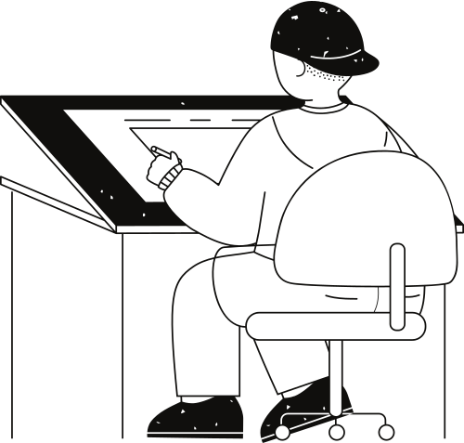





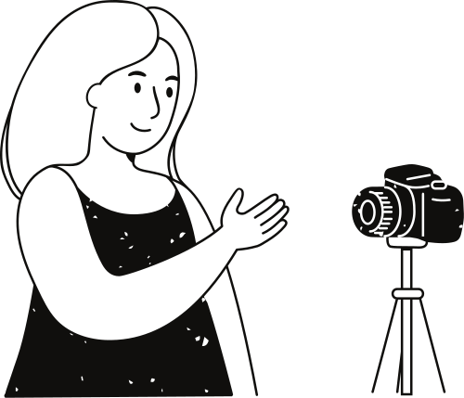
STREAMLIT
PYPDF2
Python library for creating interactive web applications with minimal code.
PyPDF2 is a library used to create, manipulate and decode portable documents.
PANDAS
Tech Stack
WORDCLOUD
Pandas is a Python library used for working with data sets. It has functions for analyzing, cleaning, exploring, and manipulating data.
Word clouds or tag clouds are graphical representations of word frequency that give greater prominence to words that appear more frequently in a source text
Libraries used
OPENCV
MEDIAPIPE
OpenCV (Open Source Computer Vision Library) is an open source computer vision and machine learning software library
MediaPipe is an open-source framework for building pipelines to perform computer vision inference over arbitrary sensory data such as video or audio.

Slide 4
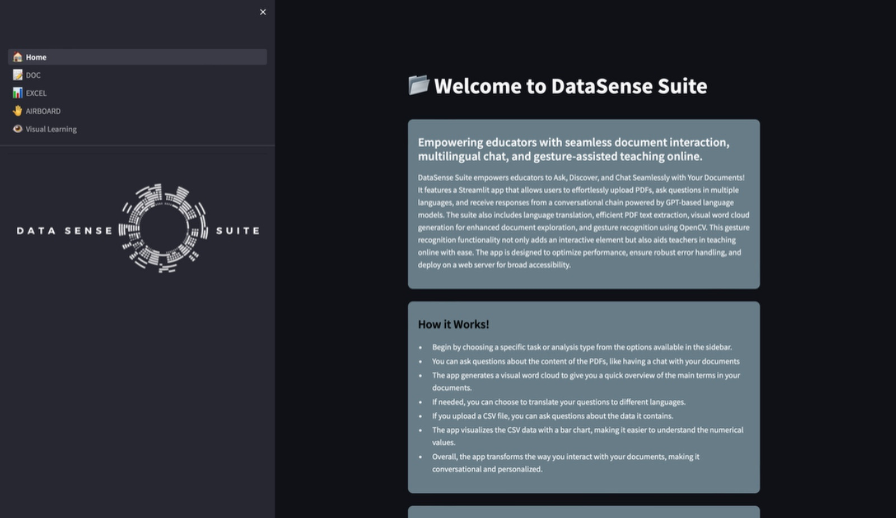

Slide 5
Team SIEMplicity
Asma Khanam
Md Ameer
Syed Tajuddin
Mohd Vaiz

Slide 6
Thank you very much!

